Slide 1
Welcome to
Year 2W
Miss Winskill

Slide 2
Returning from Lockdown
For obvious reasons, this September our return to school is somewhat unusual due to Covid-19.
We'll be focussing very much on ensuring the children settle back into school in a positive way and that any anxieties related to coronavirus or lockdown are handled and supported sensitively.
We're following Gateshead's 'Recovery Curriculum' - means that the children will cover all their 'missed' learning. In school, we're avoiding any talk of 'catch-up' or 'lost learning/time' as we need to ensure the children feel positive about returning.

Slide 3
Staffing
Year 2W are taught by
Miss Winskill
Mrs Ledger and Mrs Edmondson (in class support)
Miss Edmondson (PPA Cover)
Intervention and support
Miss Winskill will deliver small group interventions during assembly time and during dedicated intervention time

Slide 4
Routines
English and Maths, including discrete SPAG sessions, are taught daily and usually in the mornings.
All other subjects- including guided reading, are taught in the afternoon.
PE is on a Monday and Wednesday and children should come to school in their PE kit on those days.
Initially, homework tasks and spellings will be posted on the school website each week, after which we will be moving to an e-learning system. Information about this will be shared later this half term.
Two reading books will be sent home at a time (where possible). Returned books will be quarantined.

Slide 5
Our Topics
This half term in our English lessons we will be reading, ‘How to Wash a Woolly Mammoth’ and using it as our stimuli. We will be using it to help us produce descriptive writing and instructions. We will also continue to focus on our handwriting.
In Maths this term, we will focus on place value, properties of shapes, addition, subtraction and measurement.
Wider curriculum topics are the Life for Granny (1950s), Plants and looking at skylines in Art.

Slide 6
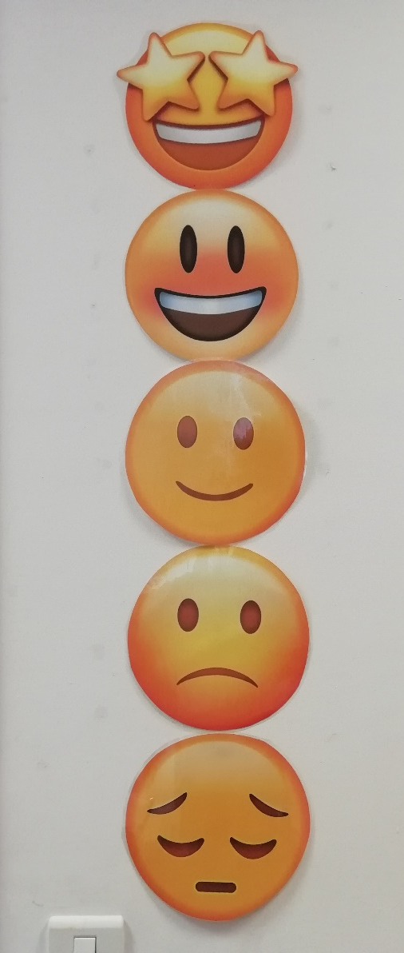
Focussing on great behaviour…
As last year, all classes will be using our sliding scale to promote positive behaviour and give all children the chance to rectify poor choices.
This will work alongside our School Rules…

Slide 7
Our Golden Rules
We keep our hands, feet, objects and personal comments to ourselves.
We are polite: we show good manners.
We always listen to adults and follow instructions on the first time of asking.
We walk at all times when moving around the school.
We take care of everyone and everything.
We always work hard and never waste time.

Slide 8
Medication and Absence
All medical needs should be shared as soon as possible to ensure we can support your child effectively. Any medication needs to be prescribed and be labelled. The office staff oversee medication in school so they may be in touch for more serious conditions or to clarify medication.
Absence simply needs to be reported to the office staff and any requests for absence need to be submitted in writing to Mrs Clarke.

Slide 9
Who to see for what!
For any minor, day-to-day issues, simply speak to any member of staff on the yard at drop-off or email the school office.
For any issues that may require more than a brief chat, please contact me via the school office and I will get in touch with you as soon as I can…
rgps@gateshead.gov.uk
01207 549359
If you need to discuss a more personal issue, anything related to safeguarding or if it is a whole school matter, appointments can be made to see Mrs Clarke or Mr Boddy simply by catching them on the yard or contacting the school office.

Slide 10
Useful things to share
We’d love to share your child’s successes outside of school, so do share them with us (send an email and maybe a picture) so we can then share it in class!
Please ensure that clothes and personal belongings are named!
All payments for any school related events or services are to be made using SIMS Pay.
The school website is the key place for information both about school and also relating to our class. All letters are sent out via eSchools.

Slide 11
Thank you for coming!
Do follow school life on our website:
www.rowlandsgillprimary.org

