Slide 1

Welcome to
Year 5R
Mrs Readshaw

Slide 2
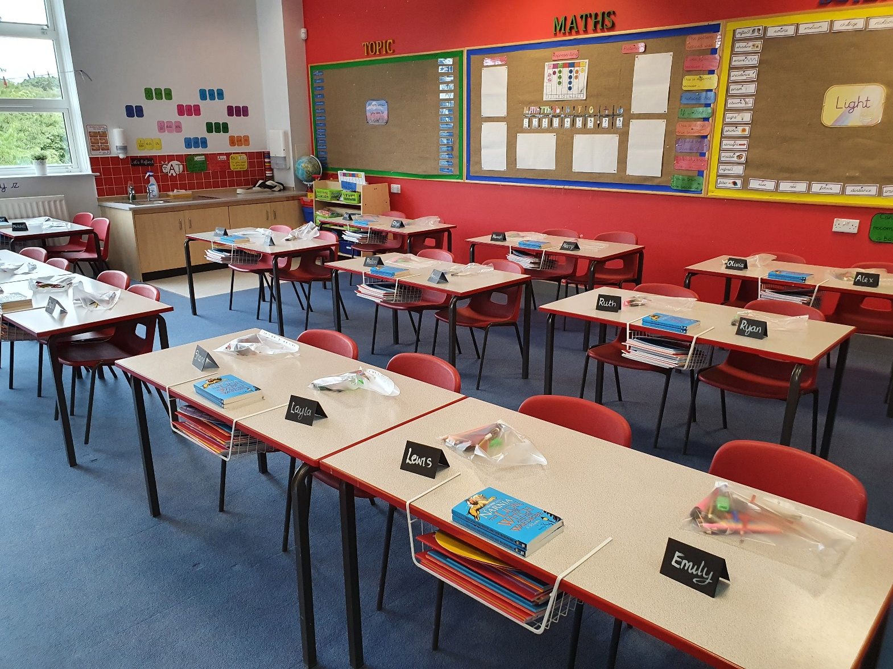
Year 5R
2020-21
Insert Class Photo

Slide 3
Returning from Lockdown
For obvious reasons, this September our return to school is somewhat unusual due to Covid-19.
We'll be focussing very much on ensuring the children settle back into school in a positive way and that any anxieties related to coronavirus or lockdown are handled and supported sensitively.
We're following Gateshead's 'Recovery Curriculum' - means that the children will cover all their 'missed' learning. In school, we're avoiding any talk of 'catch-up' or 'lost learning/time' as we need to ensure the children feel positive about returning.

Slide 4
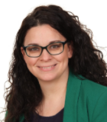
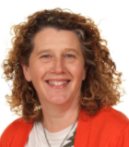
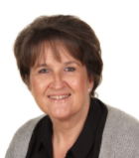
Staffing
Year 5R are taught by
Mrs Readshaw
Mrs Poad
(PPA Cover - Wednesday afternoon)
Intervention and support
Mrs Livingstone will be supporting
in class to allow targeted support
Mrs Readshaw will deliver small group interventions during assembly time

Slide 5


Routines
English and Maths, including discrete Reading and SPAG sessions, are taught daily and usually in the mornings.
All other subjects are taught in the afternoon.
PE is on a Monday and Wednesday and children should come to school in their PE kit on those days.
Initially, homework tasks/spellings will be posted
on the school website every Thursday, after which
we will be moving to an e-learning system. Information about this will be shared later this half term.
Home-readers will be sent home every Wednesday to enable quarantining to take place.

Slide 6


Our Topics
This half term in our English lessons, we will be
reading The Lion, the Witch and the Wardrobe and using it to develop our comprehension skills.
To help develop our writing skills, we will be reading Holes as our stimuli and will be using it to help us
produce impressive extended writing! We will also continue to focus on our handwriting.
In Maths this term, we will focus on place value and building confidence with calculation methods.
Wider curriculum topics are the Where would you like to live?, Light and using textiles to make a pair of slippers.

Slide 7
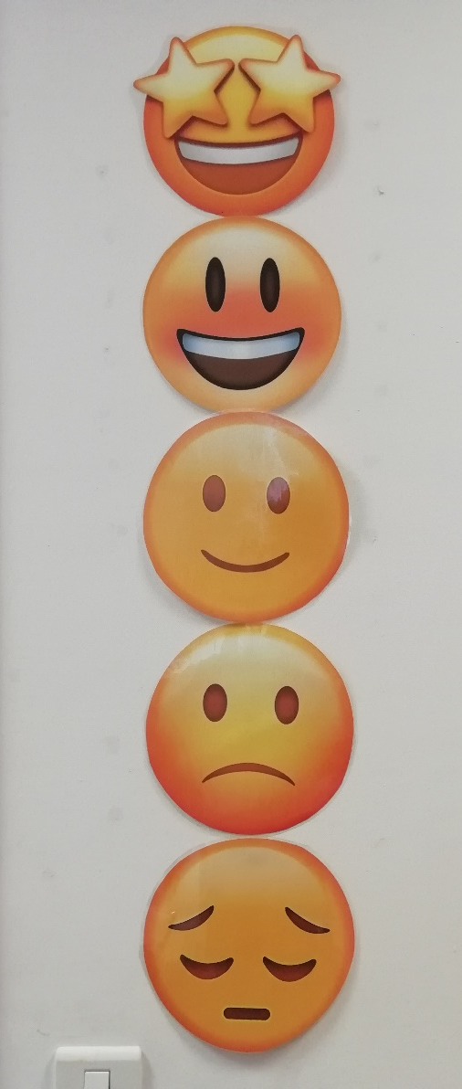
Focussing on great behaviour…
As last year, all classes will be using our sliding scale to promote positive behaviour and give all children the chance to rectify poor choices.
This will work alongside our School Rules…

Slide 8






Our Golden Rules

Slide 9
Medication and Absence
All medical needs should be shared as soon as possible to ensure we can support your child effectively. Any medication needs to be prescribed and be labelled. The office staff oversee medication in school so they may be in touch for more serious conditions or to clarify medication.
Absence simply needs to be reported to the office staff and any requests for absence need to be submitted in writing to Mrs Clarke.

Slide 10
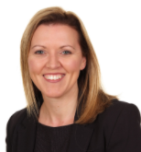
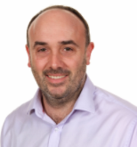
Who to see for what!
For any minor, day-to-day issues, simply speak to any member of staff on the yard at drop-off or email the school office.
For any issues that may require more than a brief chat, please contact one of us via the school office and we will get in touch with you as soon as we can…
rgps@gateshead.gov.uk
01207 549359
If you need to discuss a more personal issue, anything related to safeguarding or if it is a whole school matter, appointments can be made to see Mrs Clarke or Mr Boddy simply by catching them on the yard or contacting the school office.

Slide 11
Useful things to share
We’d love to share your child’s successes outside of school, so do share them with us (send an email and maybe a picture) so we can then share it in class!
Please ensure that clothes and personal belongings are named!
All payments for any school related events or services are to be made using SIMS Pay.
The school website is the key place for information both about school and also relating to our class. All letters are sent out via eSchools.

Slide 12
Thank you for joining me tonight!
Do follow school life on our website:
www.rowlandsgillprimary.org

