Slide 1
Welcome to
Year 7B
Miss Brown and Ms Wood

Slide 2
Year 7B
2021-22
Insert Class Photo

Slide 3
Staffing
Year 7B are taught by
Miss Brown – Mon, Tues AM, Wed, Thurs & Fri
Ms Wood- Mon, Tues, Wed, Thurs & Fri
Ms Wood- Tues PM (PPA Cover)
Intervention and support
Ms Wood will be supporting in class to allow targeted support.
Miss Brown will deliver small group interventions during assembly time.

Slide 4
Staffing
As the year progresses, your children will be spending some time in their mainstream classes. This will be on an afternoon, where they will take part in foundation subjects with their peers, e.g. PE, art, music.
During this time, Miss Brown and Ms Wood will work with targeted groups to provide intervention.

Slide 5
Routines
English and Maths, including discrete Reading and SPAG sessions, are taught daily and usually in the mornings.
All other subjects are taught in the afternoon.
PE is on a Tuesday and Thursday and children should come to school in their PE kit on those days.
Homework will be set online and the children have an exercise book to complete their work. They should bring their book into school on a Friday so we can mark it.
Home-readers have been sent home already and can be changed once completed (this does not mean after one read through though!).

Slide 6
Our Topics
This half term, in our English lessons, we will be
reading The Gingerbread Man and Egyptian Cinderella and using these texts to develop our writing skills.
To help develop our writing skills, we will be recapping the use of exciting punctuation (commas, question marks, exclamation marks) and we will be recapping how to use a range of conjunctions to make our sentences longer. We will also be writing in paragraphs, as we move on to writing longer pieces.
In maths this term, we will focus on place value of numbers to 1000 and we will be learning how to add and subtract 3-digit numbers, using a range of different methods.
Wider curriculum topics are: ‘why are rivers important?’, ‘living things and their habitats’ and sketching/painting rivers.

Slide 7
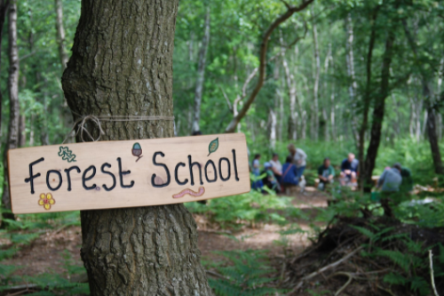
Forest School
Each class will be having a series of forest school lessons this year, lead by Mrs Beattie.
You will be informed before the sessions begin so they know what to wear and what they will be doing!

Slide 8
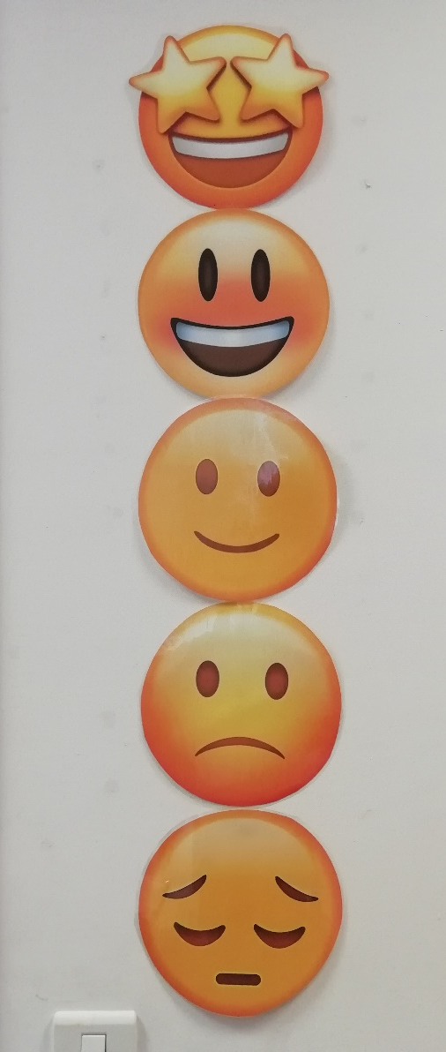
Focussing on great behaviour…
As last year, all classes will be using our sliding scale to promote positive behaviour and give all children the chance to rectify poor choices.
This will work alongside our School Rules…

Slide 9
Our Golden Rules
We keep our hands, feet, objects and personal comments to ourselves.
We are polite: we show good manners.
We always listen to adults and follow instructions on the first time of asking.
We walk at all times when moving around the school.
We take care of everyone and everything.
We always work hard and never waste time.

Slide 10
Medication and Absence
All medical needs should be shared as soon as possible to ensure we can support your child effectively. Any medication needs to be prescribed and be labelled. The office staff oversee medication in school so they may be in touch for more serious conditions or to clarify medication.
Absence simply needs to be reported to the office staff and any requests for absence need to be submitted in writing to Mrs Clarke.

Slide 11
Who to see for what!
For any minor, day-to-day issues, simply speak to any member of staff at drop-off or email the school office.
For any issues that may require more than a brief chat, please contact one of us via the school office and we will get in touch with you as soon as we can…
rgps@gateshead.gov.uk
01207 549359
If you need to discuss a more personal issue, anything related to safeguarding or if it is a whole school matter, appointments can be made to see Mrs Clarke or Mr Boddy simply by contacting the school office.

Slide 12
Who to see for what!
We also have our class email address…
lark@rowlandsgillprimary.org
You are welcome to use this at any time – just remember that we will reply within 72 hours, not necessarily on the same day.

Slide 13
Useful things to share
We’d love to share your child’s successes outside of school, so do share them with us (send an email and maybe a picture) so we can then share it in class!
Please ensure that clothes and personal belongings are named!
All payments for any school related events or services are to be made using SIMS Pay.
The school website is the key place for information both about school and also relating to our class. All letters are sent out via eSchools.

Slide 14
Thank you for coming!
Do follow school life on our website:
www.rowlandsgillprimary.org

