Slide 1

Welcome to
Class 2
Mrs Stephenson

Slide 2
Staffing
Class 2 are taught by
Mrs Stephenson – Monday, Tuesday, Wednesday and Friday
Mrs Mobberley –Thursday
Mrs King (PPA Cover)
Intervention and support
Mrs Edmondson and Mrs Hood will be supporting in class to allow targeted support.
Mrs Stephenson will deliver small group interventions during assembly time.

Slide 3
Routines
English and Maths, including discrete Reading and SPAG sessions, are taught daily and usually in the mornings.
All other subjects are taught in the afternoon.
PE is on a Monday and Wednesday and children should come to school in their PE kit on those days.
Homework tasks and spellings will be sent home on a Friday. Children to complete in their homework books. Spellings will be tested on a Friday.
Home-readers will be sent home as normal.

Slide 4
Our Topics
This half term in our English lessons, we will be
reading The Lighthouse Keeper’s lunch. There will be lots of opportunities for discussion and role play in order to support the children with their writing.
In Maths this term, we will focus on place value and building confidence with addition and subtraction methods.
Wider curriculum topics are: everyday materials in science, Grace Darling in history and making soup in D.T.
We will do a mixture of practical learning and also work in our books.

Slide 5
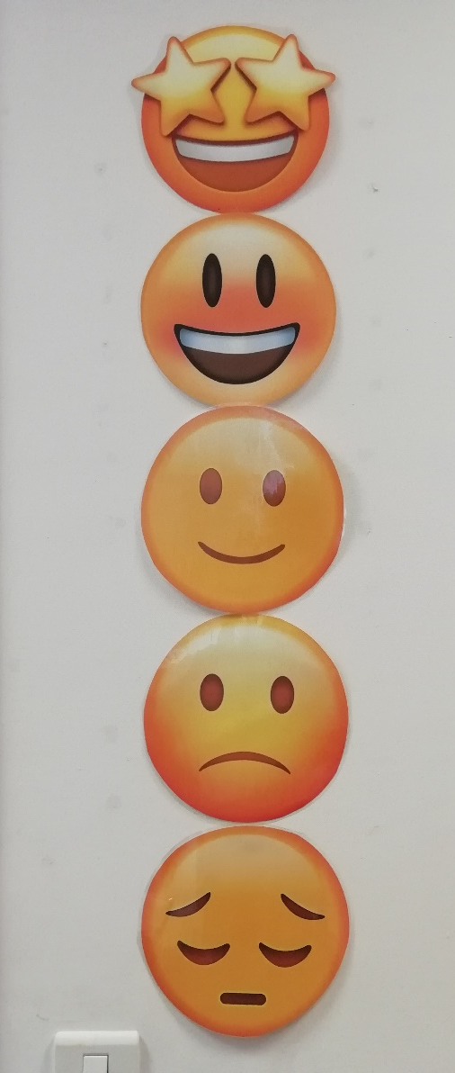
Focussing on great behaviour…
As last year, all classes will be using our sliding scale to promote positive behaviour and give all children the chance to rectify poor choices.
This will work alongside our School Rules…

Slide 6
Our Golden Rules
We keep our hands, feet, objects and personal comments to ourselves.
We are polite: we show good manners.
We always listen to adults and follow instructions on the first time of asking.
We walk at all times when moving around the school.
We take care of everyone and everything.
We always work hard and never waste time.

Slide 7
Medication and Absence
All medical needs should be shared as soon as possible to ensure we can support your child effectively. Any medication needs to be prescribed and be labelled. The office staff oversee medication in school so they may be in touch for more serious conditions or to clarify medication.
Absence simply needs to be reported to the office staff and any requests for absence need to be submitted in writing to Mrs Clarke.

Slide 8
Who to see for what!
For any minor, day-to-day issues, simply speak to any member of staff on the yard at drop-off or email the school office.
For any issues that may require more than a brief chat, please contact one of us via the school office and we will get in touch with you as soon as we can…
office@rowlandsgillprimary.org.uk
01207 549359
If you need to discuss a more personal issue, anything related to safeguarding or if it is a whole school matter, appointments can be made to see Mrs Clarke or Mr Prince simply by catching them on the yard or contacting the school office.

Slide 9
Useful things to share
We’d love to share your child’s successes outside of school, so do share them with us (send an email and maybe a picture) so we can then share it in class!
Please ensure that clothes and personal belongings are named! stork@rowlandsgillprimary.org.uk
All payments for any school related events or services are to be made using Arbor.
The school website is the key place for information both about school and also relating to our class. All letters are sent out via Arbor.

Slide 10
You can find out more about our school life on our website:
www.rowlandsgillprimary.org

