Slide 1

Welcome to
Year 4
Mrs Beattie and Mrs Cunliffe

Slide 2
Staffing
Year 4 are taught by
Mrs Cunliffe – Mon
Mrs Beattie – Tues, Weds, Thurs & Fri
Mrs Poad (PPA Cover)
Intervention and support
Miss Connelly will be supporting in class to allow targeted support.
Mrs Beattie will deliver small group interventions during assembly time.

Slide 3
Routines
English and Maths, including discrete Reading and SPAG sessions, are taught daily and usually in the mornings.
All other subjects are taught in the afternoon.
PE is on a Tuesday and Thursday and children should come to school in their PE kit on those days. They need to bring their swimming kit on the Thursday too!
Homework tasks/spellings will be handed out on a Friday and marked the following week.
Home-readers will be sent home – Children will be responsible for changing their own books.

Slide 4
Our Topics
This half term in our English lessons, we will be
reading Stig of the Dump by Clive King and using it to develop our comprehension skills.
To help develop our writing skills, we will be using the digital literacy ‘A Raindrop’s Journey’ as a stimuli and will be using it to help us produce impressive extended writing! We will focus on our handwriting and start to learn all of the Year 4 grammar features.
In Maths this term, we will focus on place value and building confidence with calculation methods. We will also look at some decimals and fractions.
Wider curriculum topics are Rivers, Animals including Humans and the artist Frida Kahlo.

Slide 5
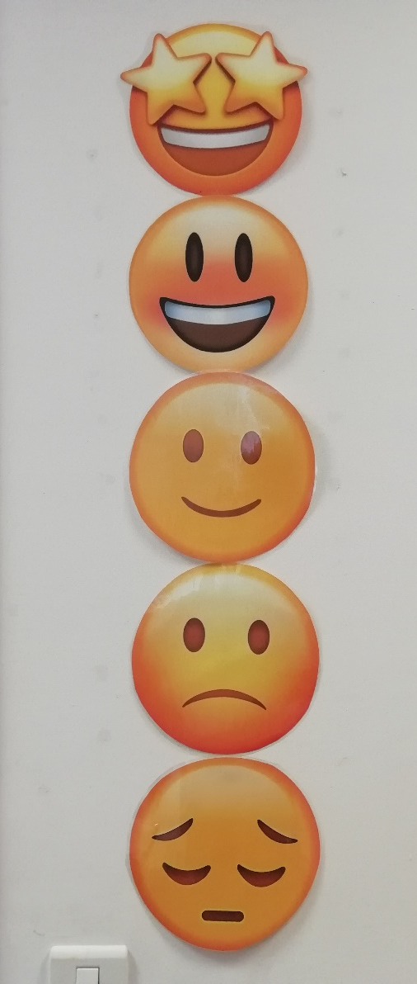
Focussing on great behaviour…
As last year, all classes will be using our sliding scale to promote positive behaviour and give all children the chance to rectify poor choices.
This will work alongside our School Rules…

Slide 6
Our Golden Rules
We keep our hands, feet, objects and personal comments to ourselves.
We are polite: we show good manners.
We always listen to adults and follow instructions on the first time of asking.
We walk at all times when moving around the school.
We take care of everyone and everything.
We always work hard and never waste time.

Slide 7
Medication and Absence
All medical needs should be shared as soon as possible to ensure we can support your child effectively. Any medication needs to be prescribed and be labelled. The office staff oversee medication in school so they may be in touch for more serious conditions or to clarify medication.
Absence simply needs to be reported to the office staff and any requests for absence need to be submitted in writing to Mrs Clarke.

Slide 8
Who to see for what!
For any minor, day-to-day issues, simply speak to any member of staff on the yard at drop-off or email the school office.
For any issues that may require more than a brief chat, please contact one of us via the school office and we will get in touch with you as soon as we can aby email at: office@rowlandsgillprimary.og.uk
Tel: 01207 549359
Or use the class e-mail: jay@rowlandsgillprimary.org.uk
If you need to discuss a more personal issue, anything related to safeguarding or if it is a whole school matter, appointments can be made to see Mrs Clarke or Mr Prince simply by catching them on the yard or contacting the school office.

Slide 9
Useful things to share
We’d love to share your child’s successes outside of school, so do share them with us (send an email and maybe a picture) so we can then share it in class!
Please ensure that clothes and personal belongings are named!
All payments for any school related events or services are to be made using Arbor.
The school website is the key place for information both about school and also relating to our class. All letters are sent out by Arbor.

Slide 10
Thank you for coming!
Do follow school life on our website:
www.rowlandsgillprimary.org

