Slide 1

Welcome to
Class 5
Mr Prince

Slide 2
Staffing
Class 5 are taught by
Mr Prince - every morning as well as Wednesday and Friday afternoons
Mrs Poad – Monday and Thursday afternoons
Mrs Cunliffe – Tuesday afternoons
Intervention and support
Mrs Poad will be supporting in class for part of each morning (Monday to Friday)
Mr Prince will deliver small group interventions during assembly time.

Slide 3
Routines
English and Maths, including discrete Reading and SPAG sessions, are taught daily and usually in the mornings.
All other subjects are taught in the afternoon.
PE is on a Tuesday and Thursday and children should come to school in their PE kit on those days.
Homework tasks and spellings will be sent home on a Friday. Children to complete in their homework in their homework books. Spellings will be tested on a Friday.
Home-readers will be sent home as normal.

Slide 4
Our Topics
This half term in our English lessons, we will use a Michael Morpurgo text called The Giant’s Necklace. We will use Narnia (The Lion, The Witch and The Wardrobe) as our guided reading text.
In Maths this term, we will be building confidence with place value, fractions, decimals and percentages, using formal methods for addition, subtraction, multiplication and division, converting units of measure, understanding properties of shapes and using data to create and interpret graphs and charts.
Wider curriculum topics are: Science, PE, Geography, PSHE, RE, Music, Art and Design, Computing and French.

Slide 5
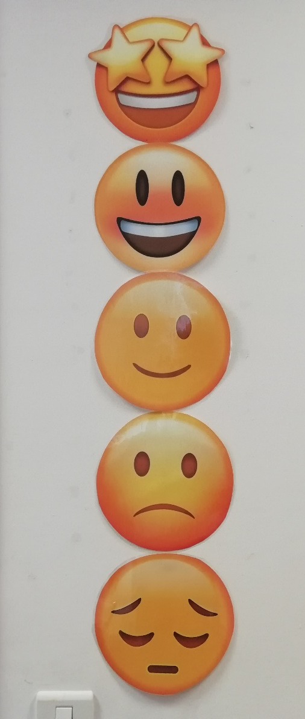
Focussing on great behaviour…
Continuing from last year, all classes will be using our sliding scale to promote positive behaviour and give all children the chance to rectify poor choices.
This will work alongside our School Rules…

Slide 6
Our Golden Rules
We keep our hands, feet, objects and personal comments to ourselves.
We are polite: we show good manners.
We always listen to adults and follow instructions on the first time of asking.
We walk at all times when moving around the school.
We take care of everyone and everything.
We always work hard and never waste time.

Slide 7
Medication and Absence
All medical needs should be shared as soon as possible to ensure we can support your child effectively. Any medication needs to be prescribed and be labelled. The office staff oversee medication in school so they may be in touch for more serious conditions or to clarify medication.
Absence simply needs to be reported to the office staff and any requests for absence need to be submitted in writing to Mrs Clarke.

Slide 8
Who to see for what!
For any minor, day-to-day issues, simply speak to any member of staff on the yard at drop-off or email the school office.
For any issues that may require more than a brief chat, please contact one of us via the school office and we will get in touch with you as soon as we can…
office@rowlandsgillprimary.org.uk
01207 549359
If you need to discuss a more personal issue, anything related to safeguarding or if it is a whole school matter, appointments can be made to see Mrs Clarke or Mr Prince simply by catching them on the yard or contacting the school office.

Slide 9
Useful things to share
We’d love to share your child’s successes outside of school, so do share them with us (send an email and maybe a picture) so we can then share it in class!
Please ensure that clothes and personal belongings are named!
Class email address: duck@rowlandsgillprimary.org.uk
All payments for any school related events or services are to be made using Arbor.
The school website is the key place for information both about school and also relating to our class. All letters are sent out via Arbor.

Slide 10
You can find out more about our school life on our website:
www.rowlandsgillprimary.org

