Slide 1

Welcome to
Reception
Mrs Sharpe – Early Years Leader and Reception Teacher
Notes:
Ruth Sharpe
Reception teacher but also lead EYFS KS1
Transition to Year 1 – here before we know it

Slide 2
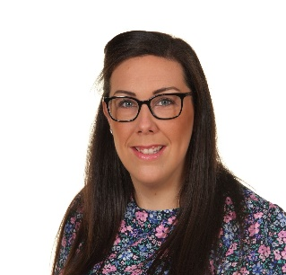
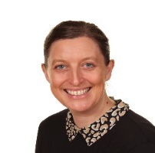
EYFS Staff
Early Years Lead and Reception class Teacher: Mrs Sharpe
Nursery Teacher: Miss Smales
Higher Level Teaching Assistant: Mrs. Andrew, Miss King and Mrs Edmondson
Teaching Assistant Mrs. Noble and Miss Malpass
Lunchtime Supervisor assigned to Reception class
Staffing
Key Workers in Reception

Slide 3
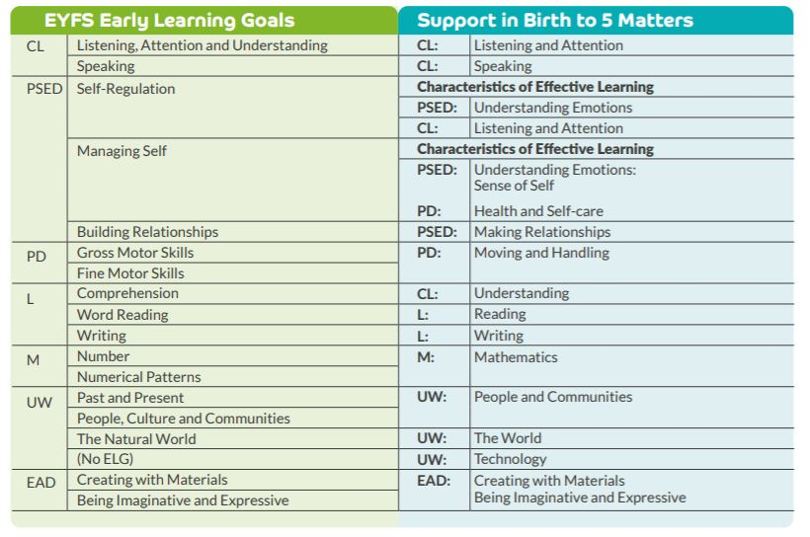
What We Learn
Notes:
The EYFS framework covers 0 to end of Reception. At the end of Reception your child will be assessed against this goal. We follow the birth to 5 documentation produced by the Government to support getting children to age related expectations. We have used the documentation to devise our curriculum to holistically develop our children looking progression in skills and knowledge to achieve the ELG and readiness for Year 1. We believe in following interest based learning for engagement as well as knowing our children’s next steps: we put each child at heart of their education. We want to develop every child who comes to RG to develop into independent and active learners. To enhance this further we meet as a team and discuss observations and children’s next steps to plan/alter the next day where needed.

Slide 4
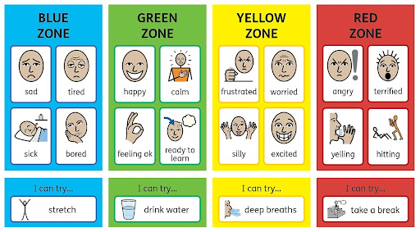
Zones of Regulation
Notes:
One way of supporting PSED is the use of Zones
We recognise the importance of promoting positive mental health and emotional wellbeing. We aim to create an open culture around the discussion of mental health and wellbeing and to empower our children be able to regulate their emotions.
By implementing the Zones of Regulation we aim to teach your child to identify emotions in themselves and others and provide them with bank of strategies to help regulate their emotions and improve their wellbeing.
This will work alongside our School Rules…

Slide 5

Our School Values and
Golden Rules
Our Values – What Matters to Us
Honesty – Understanding – Kindness – Self-belief – Respect
We are polite: we show good manners.
We keep our hands, feet, objects and personal comments to ourselves.
We walk at all times when moving around the school.
We take care of everyone and everything.
We always listen to adults and follow instructions on the first time of asking.
We always work hard and never waste time.

Slide 6


How we learn
Own and Statutory Baseline assessment: Over the first 6 weeks
Ongoing assessments to enhance provision
Welcome Time
Phonics
Maths
Plan Do Review
Story time
Notes:
Baseline- track from Rec to Year 6 – can have copy of report once done if wish but also inform next steps within parents evening in autumn term
we observe and talk with your child about what they can do and what they like to do (baseline). With this information, we plan across the 7 areas of learning, making sure we meet the needs and interests of your child(ren), providing support and challenge for each pupil to enjoy and achieve. Staff meet daily to discuss observations and plan/adapt for the next day
Observations and next steps of learning are shared through Tapestry and their paper journal.

Slide 7
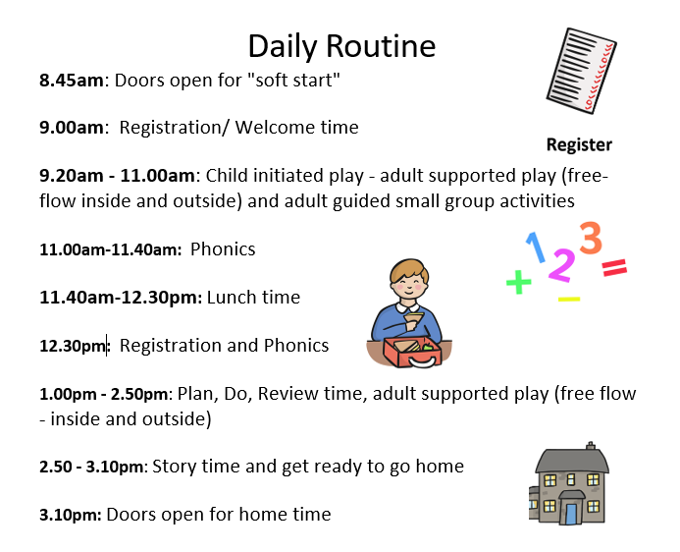

Slide 8
Phonics
Initially your child will learn how to distinguish between different sounds in the environment, instrumental sounds and listen for sounds in words.
Environmental Instrumental Sounds - Children are encouraged to listen to a wide range of instruments and makes sounds using these.
Body Percussion - Children are taught how to use their body to match songs and rhymes by clapping and tapping, for example.
Rhythm and Rhyme - Children are immersed in a world of books and young children’s rhymes. Children begin to join in with repeated language patterns and rhymes.
Alliteration - Children are made aware of the initial sounds within words and are asked to think of other words beginning with the same sound.
Voice Sounds - Children learn to create a range of mouth movements and say different sounds.
Fred Talk

Slide 9

Phonics
Phonics
Fred Talk/ Fred Fingers
Phonemes (sounds) – all words are made up of sounds
Graphemes – another name for the letters we use to write the sound
pan
p - a - n
mat
m
- a
- t
duck
d - u - ck
ship
coin
sh
- i
- p
c - oi - n
Notes:
Phonics is the method of teaching reading through the identification of sounds and graphemes.
All words are made up of sounds e.g. in ‘mat’ we have the sounds ‘m’, ‘a’, ‘t’.
A grapheme is another name for the letters we use to write the sound. Write the letters ‘m’ ‘a’ ‘t’ in the air as you say the sounds.
We teach phonics so that your children will have the tools to read any word.
It is important we use pure sounds and are conscious of adding uh to the end of the sound eg. Muh duh to avoid additional sounds being heard/written by a child
When we do these in school – I will also share videos via Tapestry to support

Slide 10
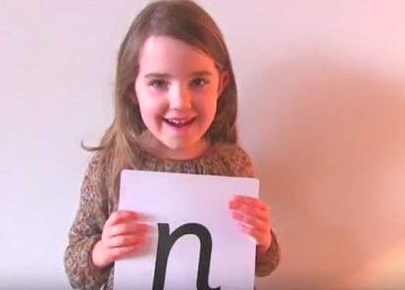
Phonics
Read Write Inc Scheme:
Structured and following same sequence each day – only thing that will change is the sound/words.
Begins with oral Blending and Segmenting of words in first half term – whole class
Move to smaller tailored groups
Pure Sounds
https://www.youtube.com/watch?v=yln6PpV1G1I
Notes:
We then move onto RWI scheme – if your child has already started these we will be revisiting to consolidate but also further challenge with reading and writing words.

Slide 11




Reading
Phonics
All children will bring home a reading for pleasure book on a Wednesday each week please take time over the weekend to share these as a family.
Your child will bring home a reading scheme book – this is to be returned daily to school. It will stay in school on a Thursday, changed and sent home on a Friday.
Phonemes (sounds) – all words are made up of sounds
Graphemes – another name for the letters we use to write the sound
mat
m
- a
- t
ship
sh
- i
- p

Slide 12
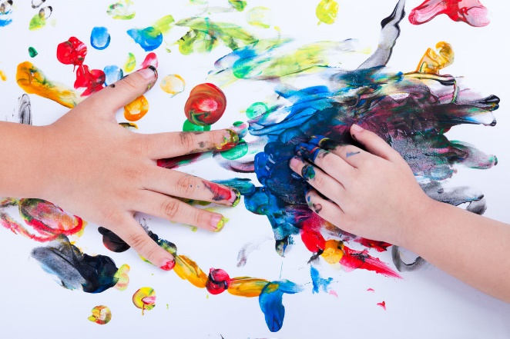
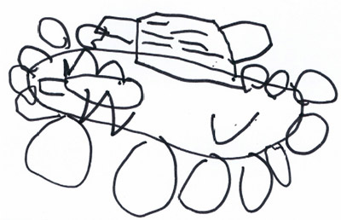
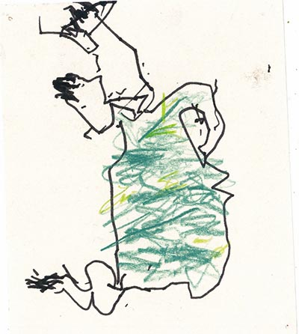
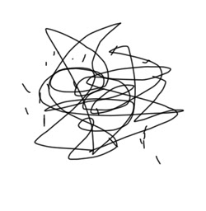
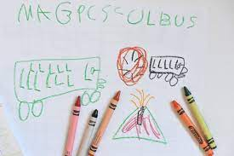
Stages of writing-
We celebrate all marks on a page!
Notes:
All marks have a meaning to a child – whether it is exploring colour and marks or if they have a meaning behind – talk through these with your child – move to pictures building stories to then them writing sentences/captions of own

Slide 13
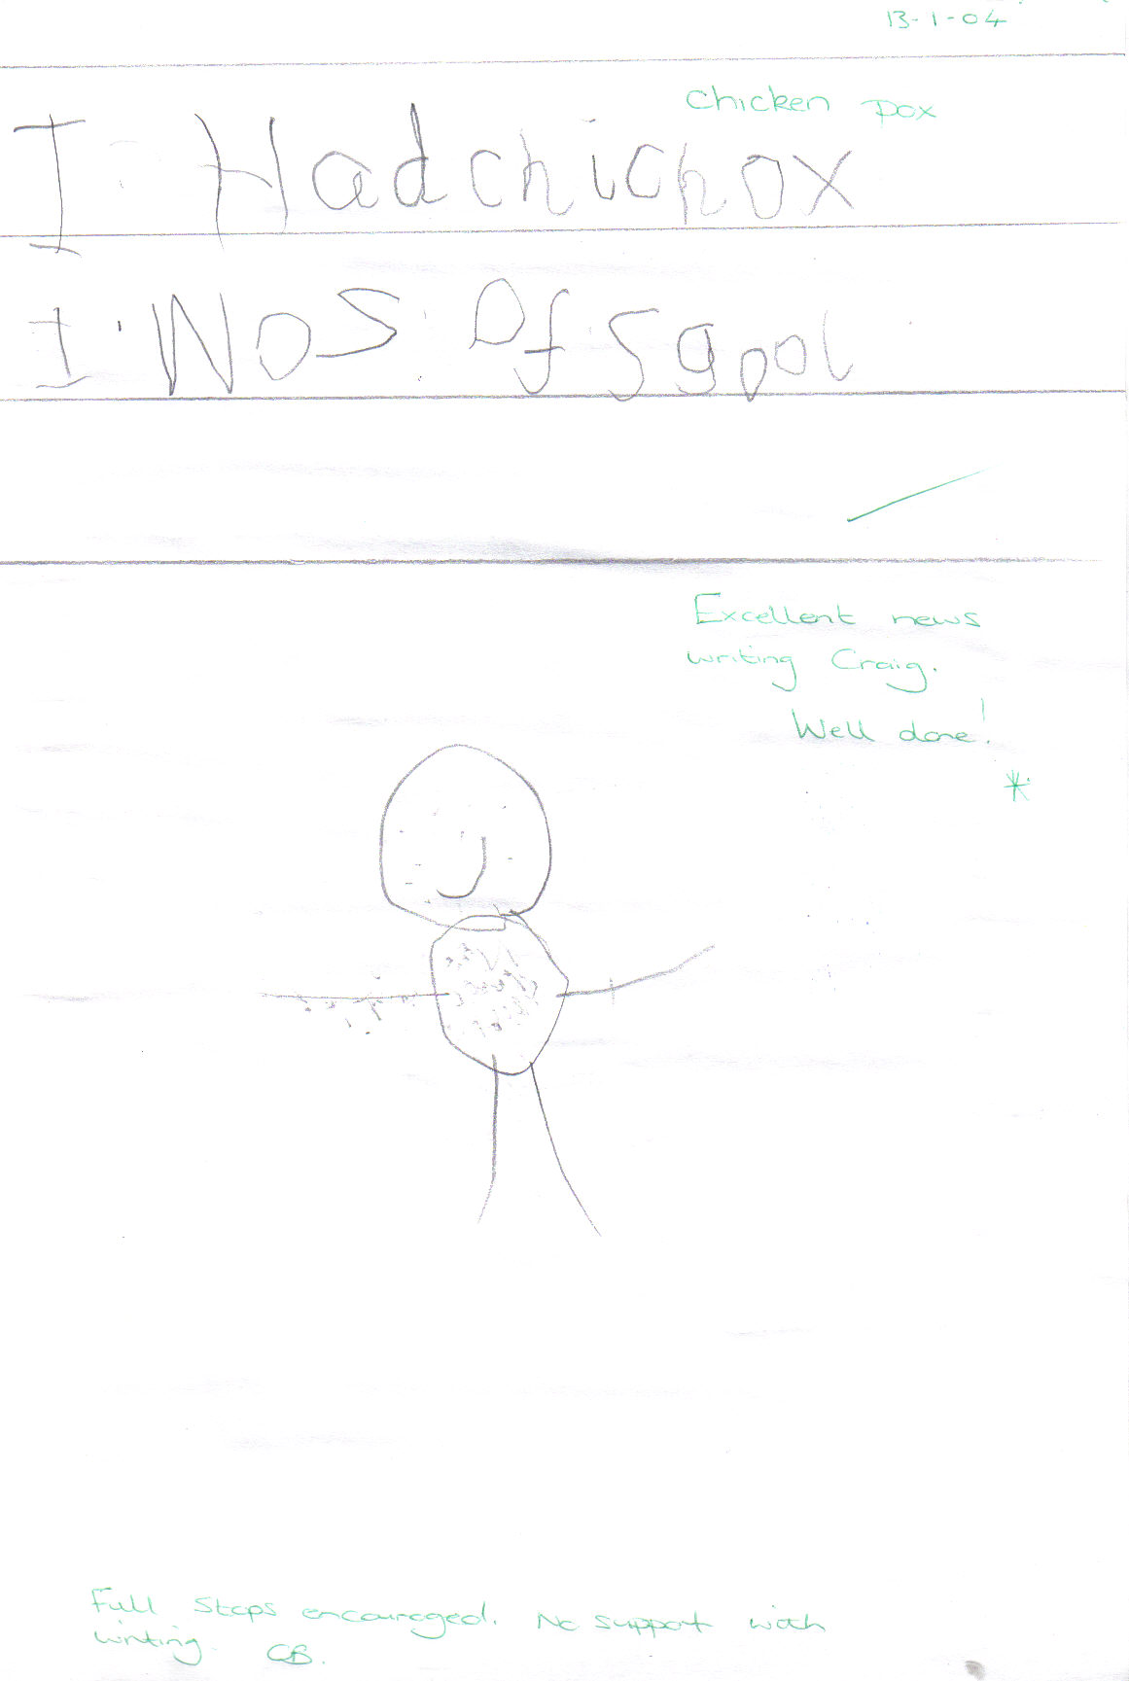
Writing
“I had chicken pox. I was off school”
Notes:
Writing builds up in stages from early mark making on a page with paint to sentence writing. The development come from talking about what these marks on the page, ground, wall mean i.e this is me, it says…. This the start of a child’s creative writing journey. Staff then move to supporting children to writing words using their phonetic knowledge.
If your child has been in our Nursery they will aware of Fred talk and even if they have not it will not be long before they as it is built into our daily routine and practice.

Slide 14
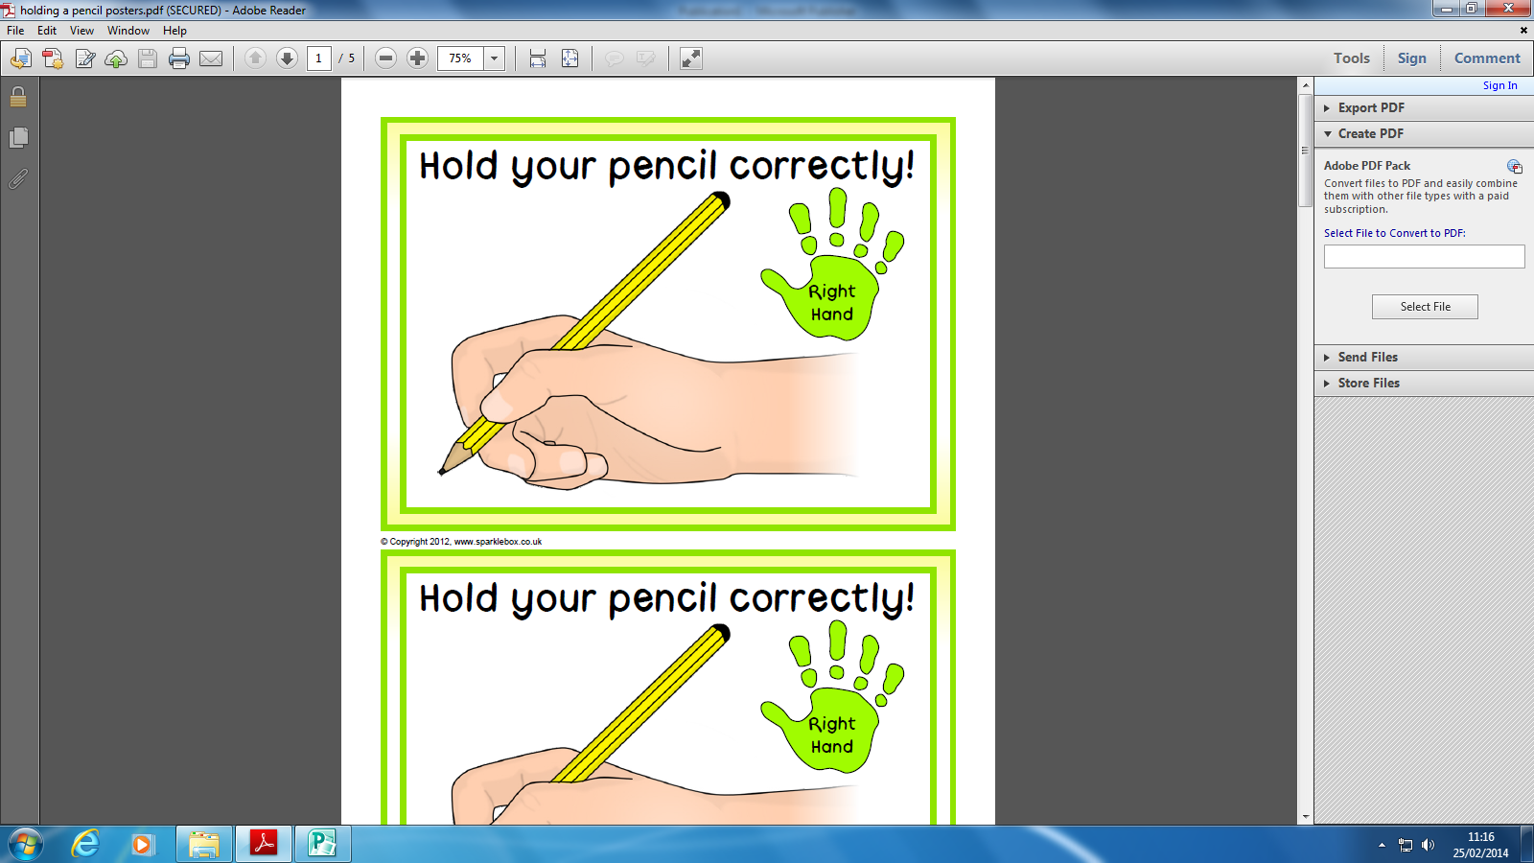
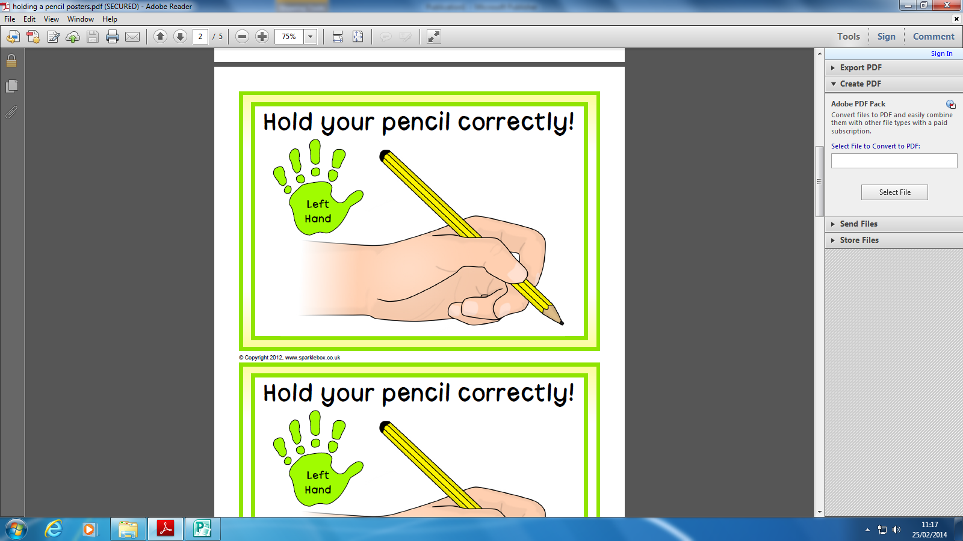
Writing
Phonics
Helping your child to use a pencil correctly
It is very important that your child learns to and feels comfortable holding a pencil correctly. The pencil should be held in a grip between the thumb and the first two fingers.
Phonemes (sounds) – all words are made up of sounds
Graphemes – another name for the letters we use to write the sound
Put the thumb and forefinger just above the cone shaped part of the pencil
Let the pencil rest between the thumb and forefinger
The put the middle finger underneath for support
Letter formation requires an anti-clockwise movement
Number formation requires a clockwise movement
mat
m
- a
- t
ship
sh
- i
- p

Slide 15
Enhanced Curriculum
Each and every child in our EYFS is unique and on their own personal journey to explore their immediate and wider world and we enhance this through purposeful real life experiences:
Curriculum based on interest
Forest school
Visits to library
Visits to TESCO
Park visit (alternate between Jesmond Dene and Saltwell Park)
Celebrations from all around the world and local environment explored
Mystery readers
Workshops
In addition to our curriculum, we are also involved in the whole school learning days, for example, the Anti Bullying Week, Nursery Rhyme Week, Music workshops and Maths Days to name a few….
Alongside the curriculum, we adapt everyday learning to meet each child’s needs and interests to plan next steps of learning.
Notes:
We want the best for our children – immerse them in as many experiences as possible in school but also use the wider world to support this further – Utw main area for development to broaden children’s understanding of environment/cultures/beliefs but also giving them aspiration for future
Part of whole school community

Slide 16
Prime Areas of Learning
• Personal, Social and Emotional Development
• Communication and Language
• Physical Development
Specific areas of learning
• Understanding the World
• Mathematics
• Literacy
• Expressive Arts and Design
Tapestry
Workbook (cross curricular)
Paper Learning Journey
Homework book
Website
How is my child’s learning recorded?
Notes:
More ways than in Nursery
You may find less as year goes on via Tapestry than nursery as year goes on – wow moment staff spending time with your child teaching rather than ipad capturing.
Shared through open door policy/parents evening/meetings requested

Slide 17
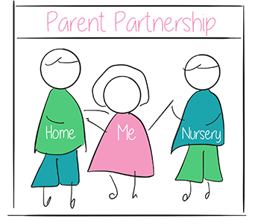
How can I help my child at home?
Talking to your child - communication is key to so many areas of a child’s development, starting with understanding words and building on sentence structure.
Waiting time ! Give your child time to process what you have asked. We usually says about 10 seconds.
Reading stories together is not only educational but what a lovely time to spend together!
Supporting your child’s independence e.g. coat, shoes, socks etc
Listening to and supporting your child with their reading book and comment in their reading record – your opinion and comments can really help us to help them.
Look through Tapestry and talk about what your child has learnt. Share your home photos too!

Slide 18
Parental Involvement
Dialogue between parent’s and teachers is extremely important to us. No one knows your child better than you do!
Notes:
It is not us being nosy – it is important to share home life so we can best support e.g. loss of a pet/family break up

Slide 19
For any minor, day-to-day issues, simply speak to any member at drop-off or email the class teacher using swan@rowlandsgillprimary.org.uk
For any issues that may require more than a brief chat, please contact one of us via the school office and we will get in touch with you as soon as we can…
office@gateshead.gov.uk
01207 549359
If you need to discuss a more personal issue, anything related to safeguarding or if it is a whole school matter, appointments can be made to see Mrs. Clarke or myself simply by catching us on the yard or contacting the school office.
Who to see for what!

Slide 20
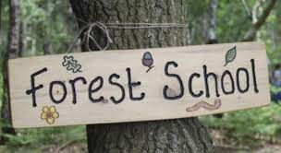
Homework will be set every Friday via Tapestry. Homework can be completed via photographs/wording on Tapestry or you/your child can record in homework books.
Home-readers will be sent home daily and your child will progress through our scheme. Your child may come home with a picture book first then progress onto phonic sound books. These books will be changed on a Thursday to be resent home on a Friday.
Reading for Pleasure books sent out every week and to be returned on a Wednesday to be changed in our library.
Forest School: we regularly go to Forest School, you will be informed when your child will go.
PE day: will be announced in September
Routines

Slide 21

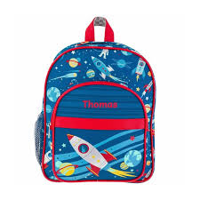
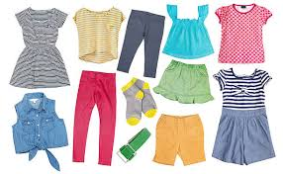
Useful things to share!
We love to explore the world around us and sometimes this can get a bit messy, also accidents do happen, please send in a bag of spare clothes (including underwear and socks) - staff will notify you when we need more items. Please send in all year round not just when your child starts Reception!
Please provide a water bottle for your child.
PLEASE ensure EVERYTHING is named!
Notes:
Can have accidents especially in autumn term

Slide 22
The school website is the key place for information both about school and also relating to our class. All letters are sent out via Arbor.
EYFS fund £1 per week
All payments for any school related events or services are to be made using Arbor.
Tapestry – online learning journal
These log ins will be sent to you as soon as your child starts in September
Useful things to share

Slide 23
Purple sweatshirt or sweatshirt cardigan (not knitted), preferably with school logo
Purple or white polo shirt, preferably with school logo
Grey school trousers or shorts (not black). Jogging bottoms can be warm to help with independent toileting.
Grey skirt or grey pinafore dress purple checked dress (in warmer weather)
School Bags
Purple school reading book bags, or small school rucksacks.
Forest School
Children can come into school wearing suitable clothing for Forest to keep them warm.
PE kits
To be sent into school in September we will change into in school (Autumn term)
Uniform
All items of clothing should be marked with your child’s name please! Please make sure that, if your child’s name is written on, it hasn’t faded after you wash the item of clothing.

Slide 24
All medical needs should be shared as soon as possible to ensure we can support your child effectively. Any medication needs to be prescribed and be labelled. The office staff oversee medication in school so they may be in touch for more serious conditions or to clarify medication.
School Calpol can be administered by a member of staff
Absence simply needs to be reported to the office staff via telephone and any requests for absence need to be submitted in writing to Mrs Clarke.
Dietary Needs or requirements. Please speak to a member of staff if your child has any dietary needs, as soon as possible. This includes Movicol and toileting issues.
Medication and Absence

Slide 25
Welcome to Reception session Wednesday 2nd July 1.00pm -2.30pm
Welcome to Reception session Monday 7th July 1.00pm -2.30pm
Start Reception Tuesday 3rd September full time unless transition arrangement have been made.
Happy to chat to any family about concerns or needs for transition – this year as last year transition will be child led and driven on need.
Transition

Slide 26
Between now and September
Practice putting on/taking off and fastening/unfastening coats and shoes
Share stories from when you were at school
Look back over Tapestry/transition books
Look at the Reception class page with your child
Talk to your child about us and School
Label EVERYTHING
Enjoy a break and don’t worry!
Phonemes (sounds) – all words are made up of sounds
Graphemes – another name for the letters we use to write the sound
mat
m
- a
- t
ship
sh
- i
- p
Notes:
Any child who does not attend our Nursery will be given a transition book at their second afternoon – this will have include photos of the classroom, photos of them in the classroom and may include any ‘work’ they have produced.
In your welcome booklet there is a page you can rip out with days to remember to help you to track what needs to be brought in when

Slide 27
Any questions?
Thank you for listening!
Do follow school life on our website:
www.rowlandsgillprimary.org

